Slide 1

Restaurant Location Data Analysis –Abu Dhabi ,UAE

Slide 2
Identify cities with restaurant distribution
Restaurant Chain business group want to start to restaurant branches in different part Abu Dhabi City in United Arab Emirates. The business group approached Us to analyze the location data and provide recommendation using the data science methods.
Location Abu Dhabi has many cities and different types of restaurants serving the people .Our Client require to have information about cities which highest concentration of different types of restaurants and each city which type of restaurant are common in ranking.

Slide 3
Data Acquisition
Following Sources are used data collection
➢ List of Shortlisted cities
➢ Using Geopandas library find the coordinates of cities
➢ Using foursquare APIs find the venues in each city and its details required for the analysis

Slide 4
Ranking most common restaurant types by cities
 | Neighbourhood | 1st Most Common Venue | 2nd Most Common Venue | 3rd Most Common Venue | 4th Most Common Venue | 5th Most Common Venue | 6th Most Common Venue | 7th Most Common Venue | 8th Most Common Venue | 9th Most Common Venue | 10th Most Common Venue
0 | Al Aman | Indian Restaurant | Middle Eastern Restaurant | Yemeni Restaurant | Gluten-free Restaurant | Lebanese Restaurant | Asian Restaurant | Chinese Restaurant | Japanese Restaurant | Iraqi Restaurant | Indian Chinese Restaurant
1 | Al Dhafrah | Chinese Restaurant | Filipino Restaurant | Indian Restaurant | Asian Restaurant | Middle Eastern Restaurant | Pakistani Restaurant | Seafood Restaurant | Mediterranean Restaurant | Italian Restaurant | German Restaurant
2 | Al Karama | Indian Restaurant | Filipino Restaurant | Korean Restaurant | Seafood Restaurant | French Restaurant | Eastern European Restaurant | Pakistani Restaurant | African Restaurant | Vegetarian / Vegan Restaurant | Chinese Restaurant
3 | Al Khalidyah | Turkish Restaurant | Middle Eastern Restaurant | Japanese Restaurant | Iraqi Restaurant | American Restaurant | Indian Restaurant | Moroccan Restaurant | German Restaurant | Indian Chinese Restaurant | Halal Restaurant
4 | Al Khubeirah | Middle Eastern Restaurant | Italian Restaurant | Turkish Restaurant | German Restaurant | American Restaurant | Asian Restaurant | Seafood Restaurant | Yemeni Restaurant | Indian Restaurant | Indian Chinese Restauran

Slide 5
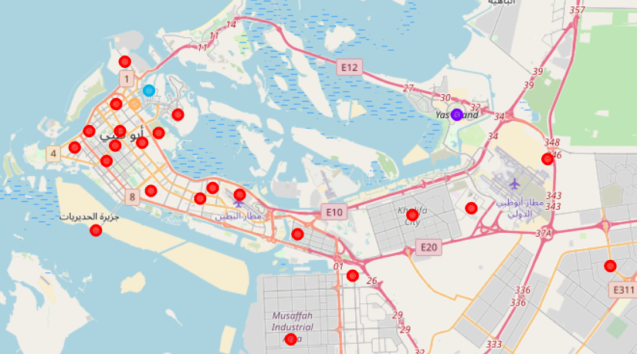
Restaurant type by clusters

Slide 6
Conclusion
In this study, I analyzed the location data of different cities of Abu Dhabi in order to find the presence of restaurant types by clustering and listed in each cluster which restaurant type has most common.

